Slide 1
Setting up an ibutton
Start viewer
Determine mission parameters
Set the clock.
Set the time alarm.
Set the sample rate.
Set the temperature/humidity alarm.
Set the mission start delay.
Check when mission will end; select data rollover or not.

Slide 2

ibutton diagram
i/o or “lid”

Slide 3
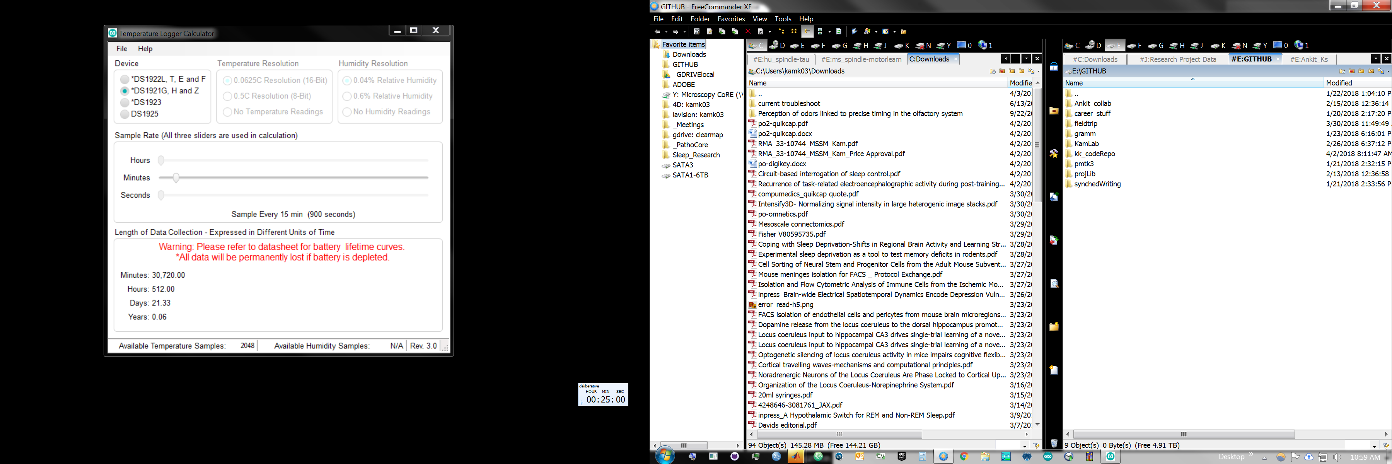
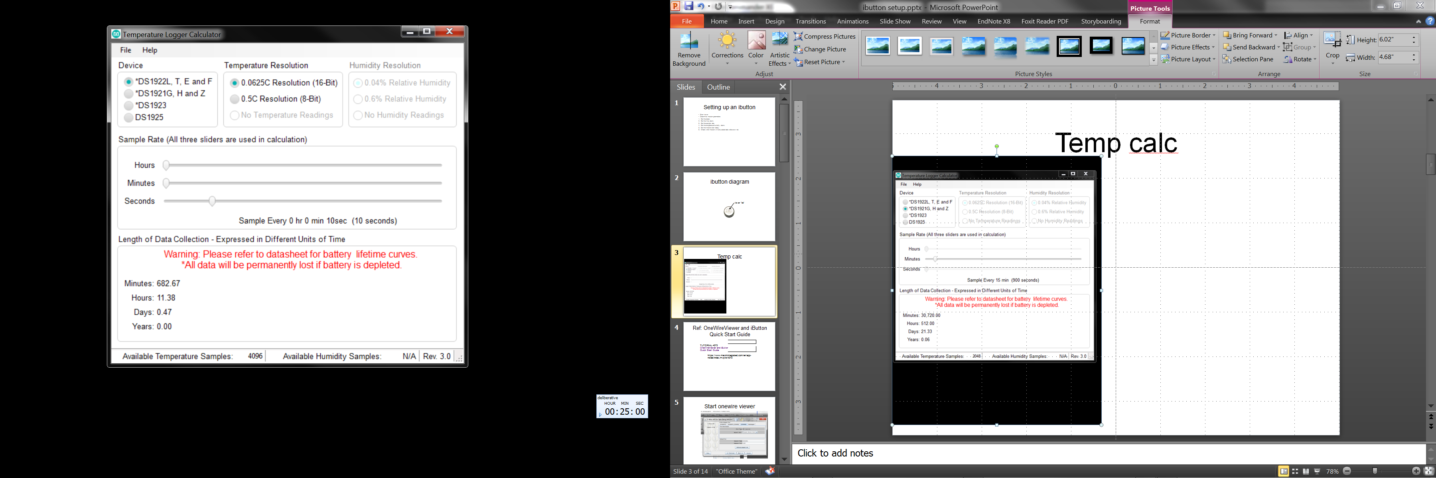
Temp calc
DS1921H
DS1922X

Slide 4
Ref: OneWireViewer and iButton Quick Start Guide
TUTORIAL 4373
OneWireViewer and iButton Quick Start Guide
https://www.maximintegrated.com/en/app-notes/index.mvp/id/4373

Slide 5
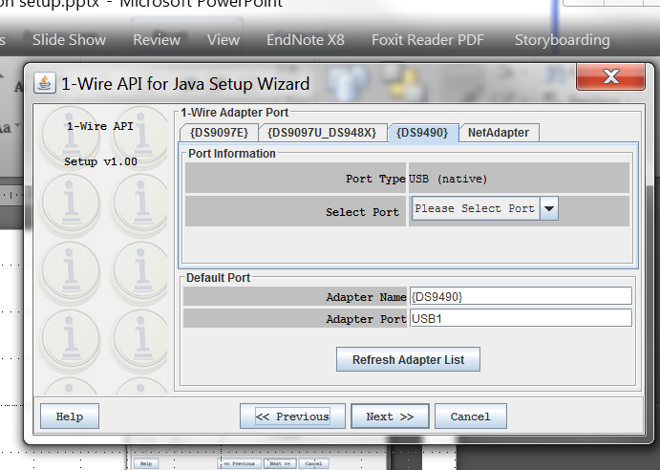
Install 1-Wire viewer

Slide 6
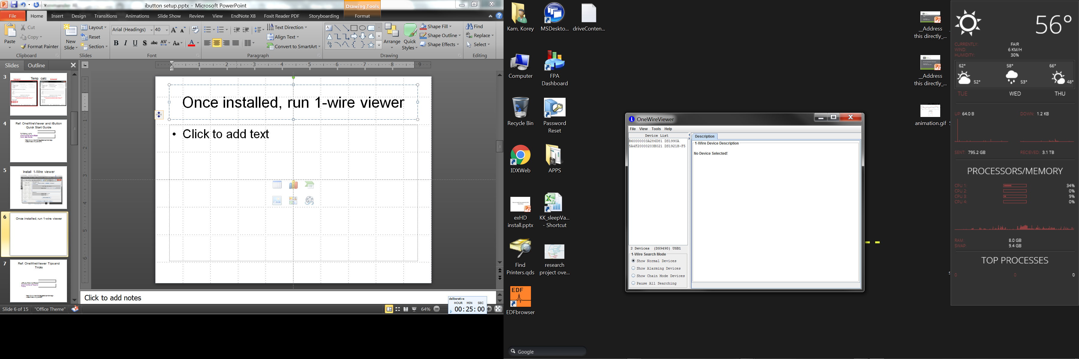
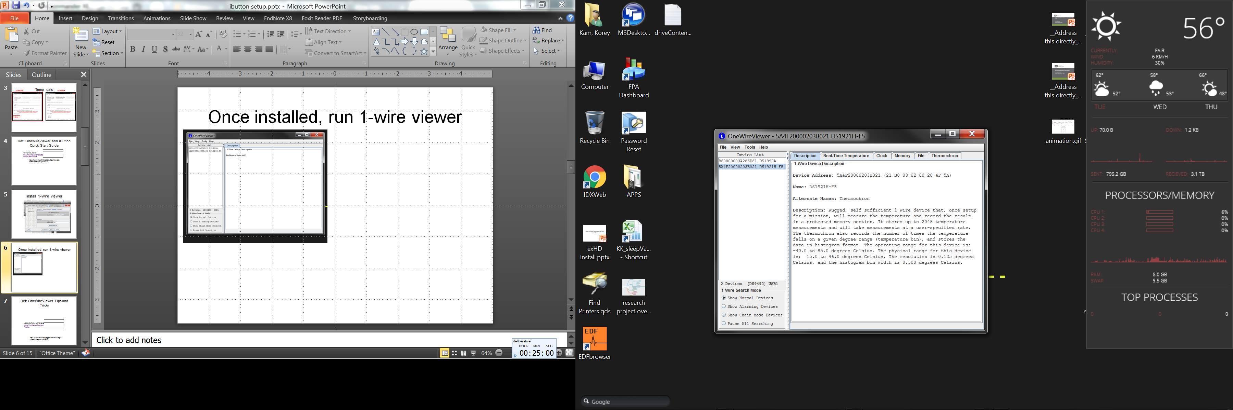
Once installed, run 1-wire viewer
Select device

Slide 7
Ref: OneWireViewer Tips and Tricks
APPLICATION NOTE 5057
OneWireViewer Tips and Tricks
https://www.maximintegrated.com/en/app-notes/index.mvp/id/5057

Slide 8
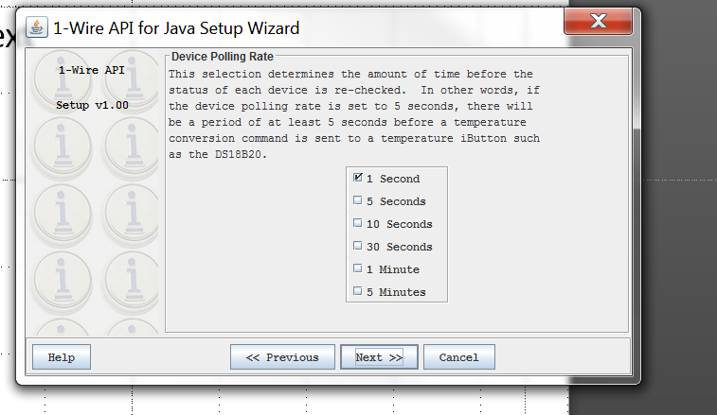
Polling rate
https://www.maximintegrated.com/en/app-notes/index.mvp/id/5057

Slide 9
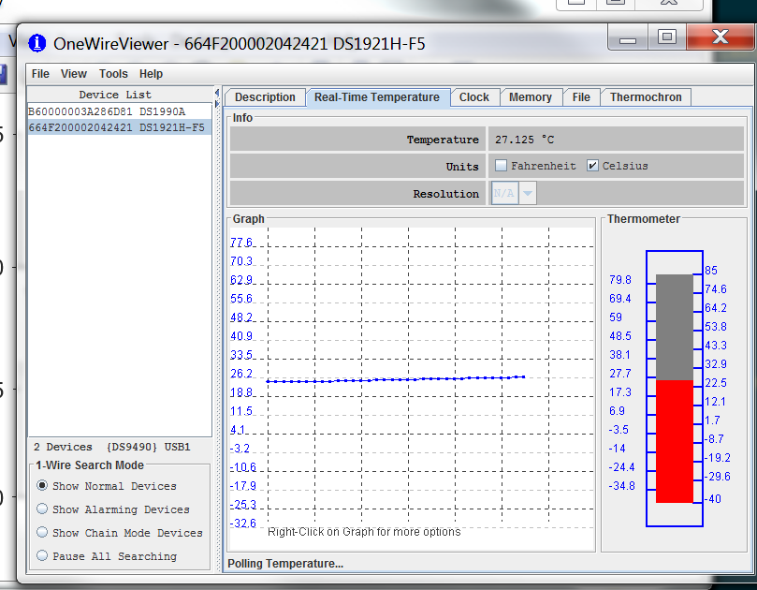
Check real-time temp

Slide 10
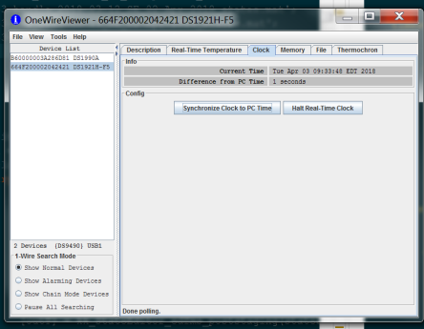
Synch clock to comp

Slide 11
Ref: Determining the Mission Parameters for Temperature Logger iButton® Devices
Determining the Mission Parameters for Temperature Logger iButton® Devices
https://www.maximintegrated.com/en/app-notes/index.mvp/id/5335
APPLICATION NOTE 5335

Slide 12
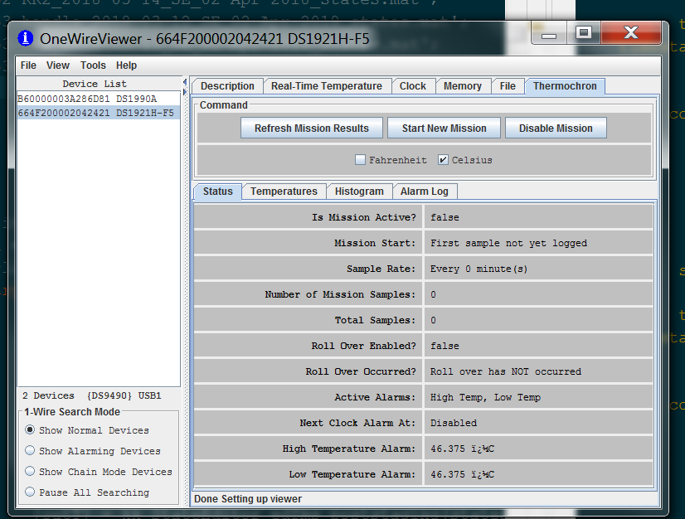
Thermochron tab

Slide 13
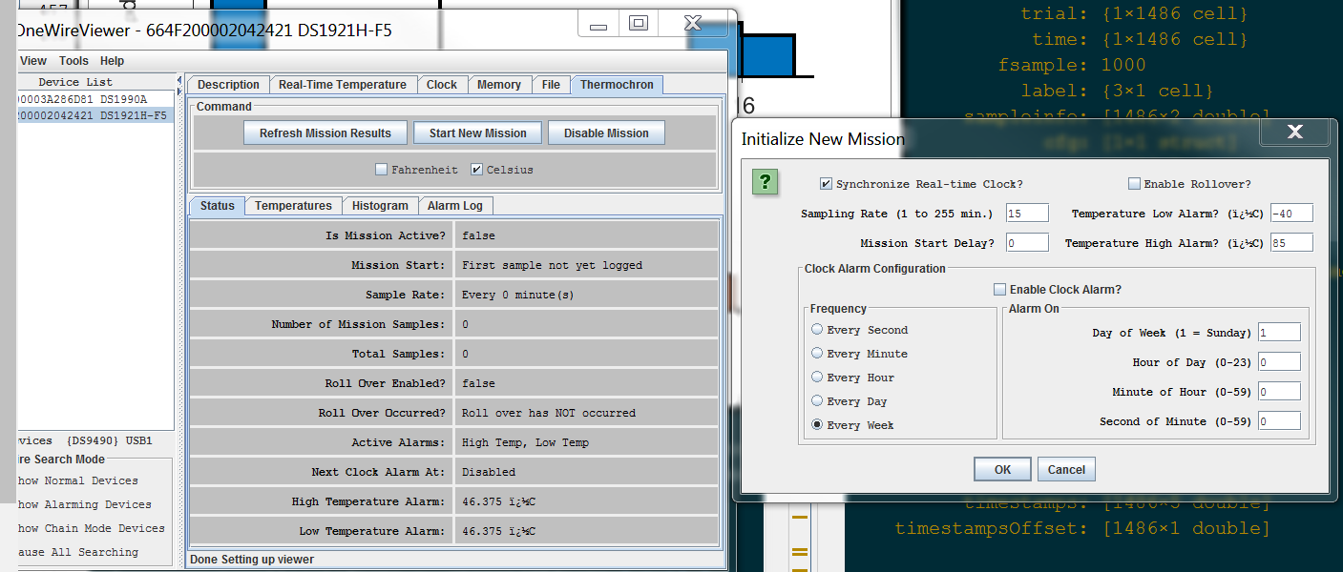
Select mission parameters

Slide 14
Extracting data
APPLICATION NOTE 3809
Exporting DS192x Logger Data from the OneWireViewer into Excel
Ref: https://www.maximintegrated.com/en/app-notes/index.mvp/id/3809

Slide 15
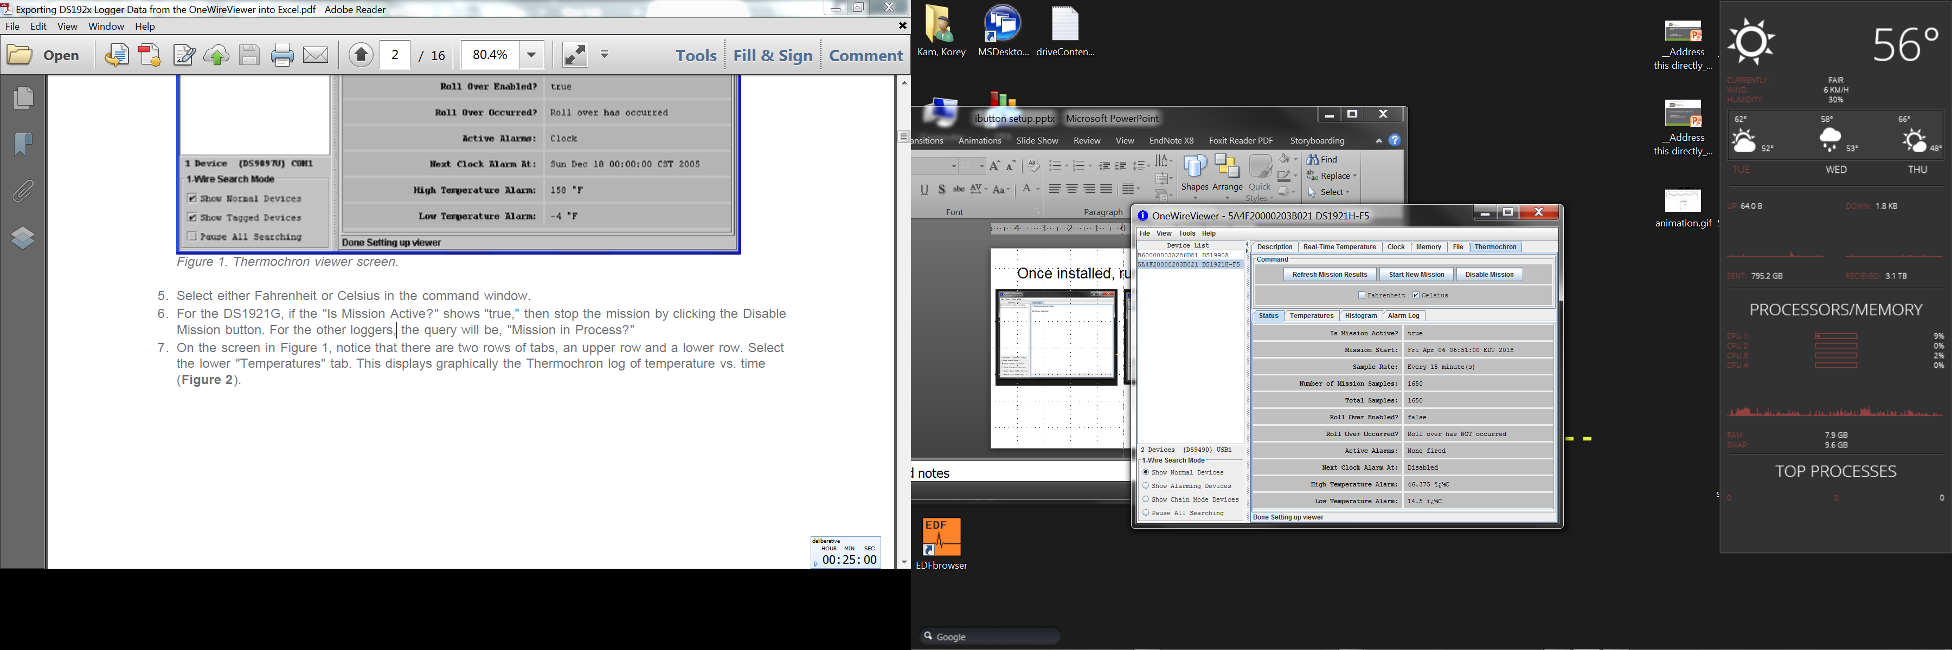
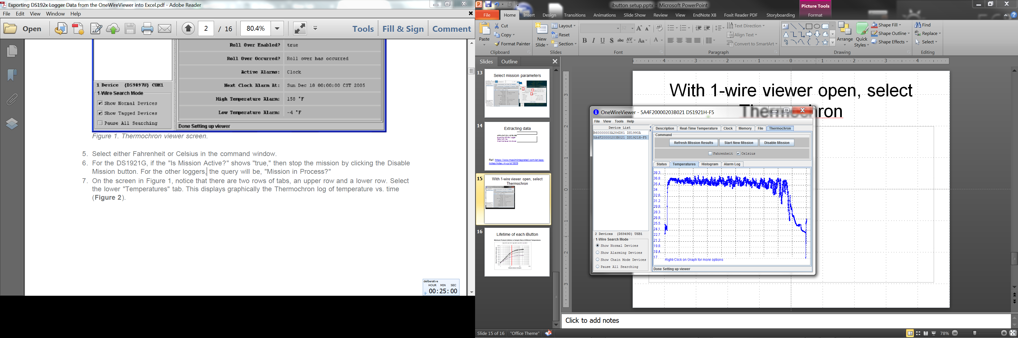
With 1-wire viewer open, select Thermochron

Slide 16
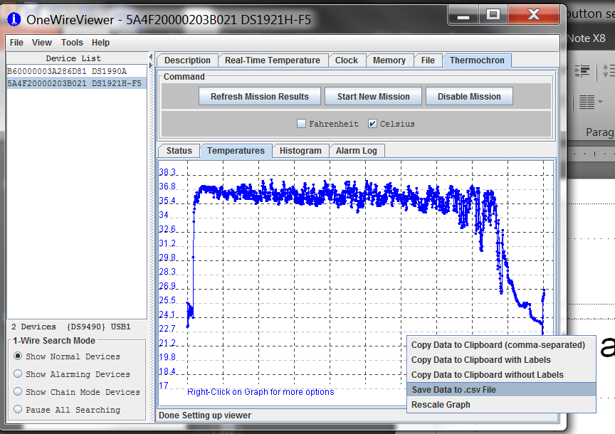
Export to csv

Slide 17
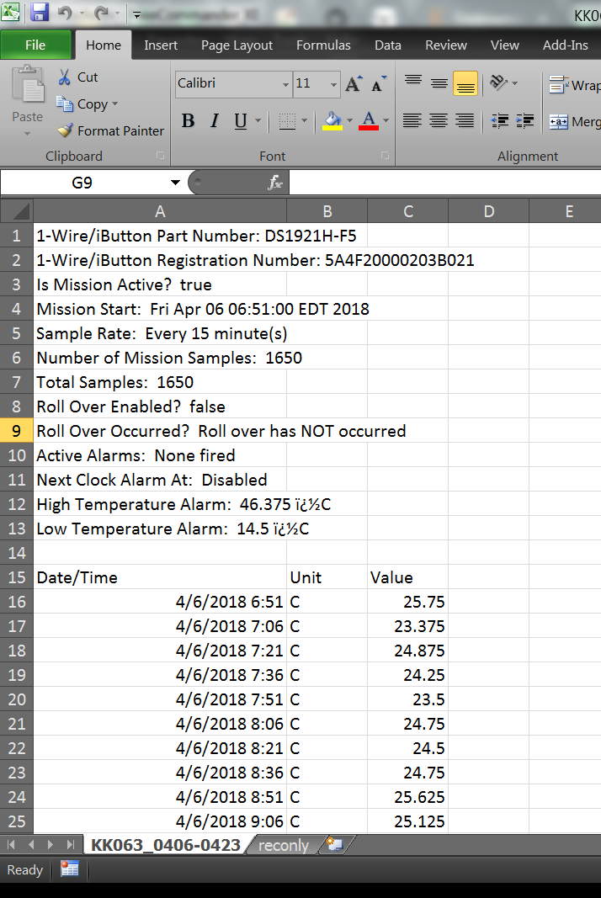
Save file as .xlsx into …\_DATA\ms\Thermochron
Analyze in matlab

Slide 18
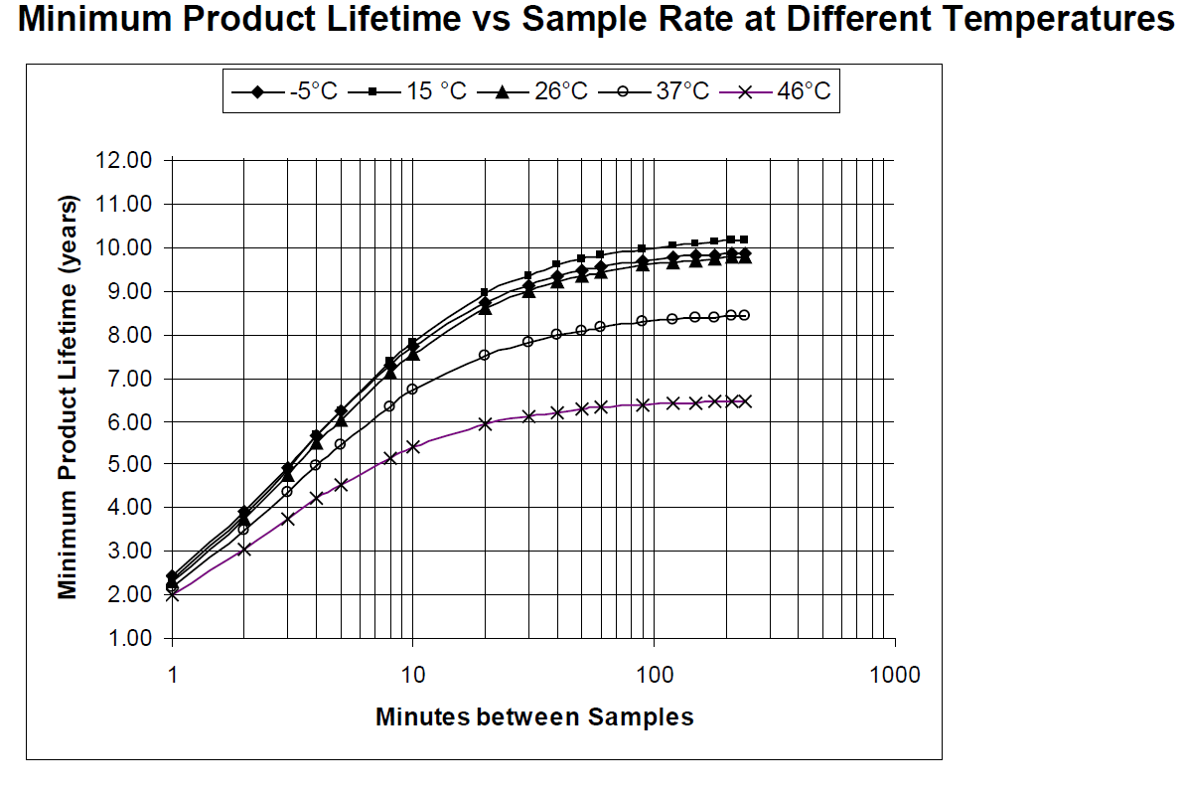
Lifetime of each iButton

